Slide 1
Visual Sentiment Analysis
Using EMOTIC Dataset

Slide 2
Presentation Outline
01
02
03
Introduction
Problem Statement
Dataset Description
04
Dataset Preprocessing
05
06
Data Augmentation
Label Balancing
Pre Trained Models
07
08
Training Model
09
Comparison of Model

Slide 3



Introduction

Slide 4

Introduction
Emotion recognition is the process of identifying human emotions from facial expressions.
It has many applications, including marketing, healthcare, education, and security.
One popular dataset for emotion recognition is the EMOTIC dataset, which contains over 24,000 images labeled with 26 emotions.
In this project, we will build a deep learning model to classify emotions in the EMOTIC dataset using pre-trained models and transfer learning techniques.
The purpose of this presentation is to demonstrate how to use pre-trained deep learning models to classify emotions in the EMOTIC dataset and compare their performance with different optimizers.

Slide 5
Problem Statement
The problem statement for the emotion recognition task is to accurately identify the emotion expressed in a given image using machine learning algorithms.

Slide 6
Challenges
The challenges associated with this task include:
Variability in human emotions: Human emotions can be complex and subtle, making it difficult to accurately capture and represent them in a dataset.
Ambiguity in facial expressions: Facial expressions can be ambiguous, with the same expression potentially representing different emotions in different contexts.
Limited availability of labeled data: Emotion recognition datasets are relatively small and may not fully capture the diversity of emotions expressed in real-world scenarios.

Slide 7
Project Goal
The goals of the project are to:
Train and evaluate deep learning models for emotion recognition using the EMOTIC dataset.
Compare the performance of different pre-trained models and optimizers on this task.
Generate insights into the strengths and limitations of current emotion recognition methods.

Slide 8
Dataset Description

Slide 9
EMOTIC Dataset
EMOTIC dataset is a collection of images of people in unconstrained environments annotated according to their apparent emotional states.
This dataset can accessed by taking permission from the Emotic Dataset Contributor from their Emotic Set.
This Dataset comprises of images from COCO and Ade20k public benchmark datasets.
The Dataset is annotated using Amazon Mechanical Turk (AMT)

Slide 10
EMOTIC Dataset
There are 26 Emotion in Dataset which annotated using AMT.
The Emotions are:
Embarrassment
Engagement
Esteem
Excitement
Fatigue
Fear
Happiness
Pain
Peace
Pleasure
Affection
Anger
Annoyance
Anticipation
Aversion
Confidence
Disapproval
Disconnection
Disquietment
Doubt
Sadness
Sensitivity
Suffering
Surprise
Sympathy
Yearning

Slide 11
Data Preprocessing

Slide 12
Data Preprocessing
Data preprocessing is an important step in any machine learning project, and it involves transforming raw data into a format that can be used by the model.
The following are the steps involved in preprocessing the EMOTIC dataset:
01
02
Image Resizing
The images in the EMOTIC dataset are of varying sizes, so they are resized to a standard size of 224x224 pixels.
Image Augmentation
The dataset is augmented using various techniques such as horizontal and vertical flipping, rotation, zooming, and shearing. This is done to increase the size of the dataset and to make the model more robust to variations in the data.

Slide 13
Data Preprocessing
Data preprocessing is an important step in any machine learning project, and it involves transforming raw data into a format that can be used by the model.
The following are the steps involved in preprocessing the EMOTIC dataset:
03
04
Normalization
The pixel values in the images are normalized to lie between 0 and 1. This is done to ensure that the model can handle the data more efficiently.
Data Splitting
The dataset is split into training, validation, and testing sets. The training set is used to train the model, the validation set is used to tune the hyperparameters of the model, and the testing set is used to evaluate the performance of the final model.

Slide 14

Significance of Preprocessing
Preprocessing is an important step in machine learning that involves transforming raw data into a format that is suitable for use in a model.
In the case of image classification, preprocessing involves applying a series of transformations to the images to standardize them and make them easier for the model to learn from.
This can include resizing the images to a common size, applying normalization to ensure that all pixel values fall within a certain range, and performing data augmentation to increase the size of the training set and reduce overfitting.
Preprocessing is important because it can significantly improve the performance of a model by making the data easier to learn from and reducing the impact of noise and other sources of variability in the data.

Slide 15
Data Augmentation

Slide 16



Data Augmentation
Data augmentation is the process of generating new training samples by applying various transformations to the original dataset. It is an important technique in machine learning to improve model performance and prevent overfitting.
In this project, we used the following data augmentation techniques:
Horizontal flip: This technique flips the image horizontally, which increases the diversity of the dataset.
Width and height shift: This technique randomly shifts the image horizontally and vertically by a certain fraction, which helps to account for differences in position and orientation.
Rotation: This technique rotates the image by a certain degree, which helps to account for differences in orientation.
Zoom: This technique zooms in or out of the image by a certain factor, which helps to account for differences in scale.
Shear: This technique shears the image by a certain degree, which helps to account for differences in perspective.

Slide 17
Label Balancing

Slide 18
Label Balancing
Label balancing is important in multi-class classification problems to ensure that the model does not become biased towards certain classes due to imbalanced data.
The class distribution of the EMOTIC dataset is highly imbalanced, with some classes having much fewer samples than others. For example, the "disgust" class has only 327 samples, while the "happiness" class has 4472 samples.
To balance the labels, we used a technique called class weight balancing, which assigns weights to each class based on their frequency in the dataset. This ensures that the model pays equal attention to each class during training.

Slide 19
Pre-Trained Model

Slide 20
Pre-Trained Model
The function load_pretrained_model(model_name) takes a model_name string as input and returns a pre-trained image classification model in TensorFlow Keras.
There are six different pre-trained models to choose from: CNN, ALEXNET, VGG19, INCEPTIONV3, DENSENET121, and MOBILENETV2.
Here is a brief overview of each model:
01
02
CNN
A simple convolutional neural network with two convolutional layers and two dense layers.
ALEXNET
A convolutional neural network with 8 layers including convolutional, max pooling, and dense layers.

Slide 21
Pre-Trained Model
The function load_pretrained_model(model_name) takes a model_name string as input and returns a pre-trained image classification model in TensorFlow Keras.
There are six different pre-trained models to choose from: CNN, ALEXNET, VGG19, INCEPTIONV3, DENSENET121, and MOBILENETV2.
Here is a brief overview of each model:
03
04
VGG19
A convolutional neural network with 19 layers including convolutional, max pooling, and dense layers.
INCEPTION V3
A convolutional neural network with 159 layers that uses a novel "inception" module architecture.

Slide 22
Pre-Trained Model
The function load_pretrained_model(model_name) takes a model_name string as input and returns a pre-trained image classification model in TensorFlow Keras.
There are six different pre-trained models to choose from: CNN, ALEXNET, VGG19, INCEPTIONV3, DENSENET121, and MOBILENETV2.
Here is a brief overview of each model:
05
06
DENSENET121
A convolutional neural network with 121 layers that uses a "dense" block architecture to improve gradient flow.
MOBILENET V2
A convolutional neural network with 88 layers that is designed to be lightweight and efficient.

Slide 23
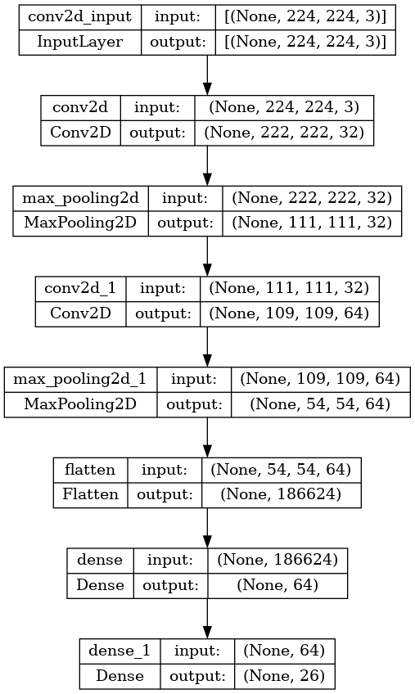
CNN
Breakdown of the Convolutional Neural Network (CNN) model architecture for emotion recognition :
tf.keras.models.Sequential: This creates a linear stack of layers that will form the model.
tf.keras.layers.Conv2D: This is a convolutional layer that applies a filter to the input image and extracts features. In this case, there are two convolutional layers, one with 32 filters and another with 64 filters. The filter size is 3x3, and the activation function used is ReLU.
tf.keras.layers.MaxPooling2D: This is a pooling layer that reduces the spatial dimensions of the output from the convolutional layers. In this case, a 2x2 max pooling is applied after each convolutional layer.
tf.keras.layers.Flatten: This flattens the output from the convolutional and pooling layers into a 1D array.
tf.keras.layers.Dense: These are fully connected layers that perform classification on the flattened input. There are two dense layers, one with 64 neurons and another with 26 neurons (the number of classes in the classification task). The activation function used for the first dense layer is ReLU, and the second dense layer has no activation function specified.

Slide 24
ALEXNET
This code builds a convolutional neural network (CNN) based on the architecture of AlexNet and fine-tunes a pre-trained VGG16 model for image classification. The architecture of the model is as follows:
Layer 1: Convolutional layer with 96 filters of size 11x11 and stride of 4, followed by batch normalization and max pooling with a pool size of 3x3 and stride of 2.
Layer 2: Convolutional layer with 256 filters of size 5x5 and stride of 1, followed by batch normalization and max pooling with a pool size of 3x3 and stride of 2.
Layer3: Convolutional layer with 384 filters of size 3x3 and stride of 1, followed by batch normalization.
Layer 4: Convolutional layer with 384 filters of size 3x3 and stride of 1, followed by batch normalization.
Layer 5: Convolutional layer with 256 filters of size 3x3 and stride of 1, followed by batch normalization and max pooling with a pool size of 3x3 and stride of 2.
Layer 6: Flatten the output of layer 5 and add a fully connected layer with 4096 units and ReLU activation, followed by dropout regularization with a rate of 0.5.
Layer 7: Add another fully connected layer with 4096 units and ReLU activation, followed by dropout regularization with a rate of 0.5.
Layer 8: Add a final fully connected layer with 26 units (the number of output classes) and softmax activation.
The code then loads a pre-trained VGG16 model, freezes its layers so that they are not trainable, and appends some additional layers to the model for fine-tuning. Specifically, it adds a flatten layer to convert the output of the VGG16 model to a one-dimensional vector, followed by a fully connected layer with 256 units and ReLU activation, dropout regularization with a rate of 0.5, and a final fully connected layer with 26 units and softmax activation.

Slide 25
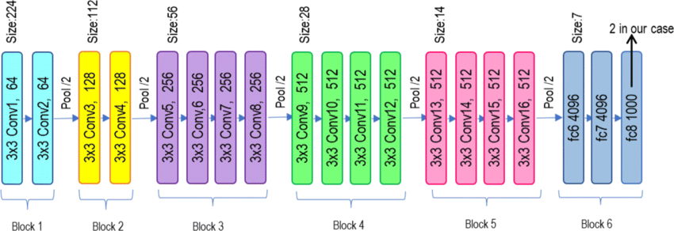
VGG19
The code is implementing the VGG19 architecture, which is a deep convolutional neural network that was first introduced in 2014. The VGG19 architecture is similar to the VGG16 architecture but has a deeper network with 19 layers.
The code first loads the pre-trained VGG19 model with the weights pre-trained on the ImageNet dataset. The include_top=False argument specifies that the fully connected layers at the top of the network should be excluded, leaving only the convolutional layers.
The next line creates a new input layer to replace the removed fully connected layers. The Flatten layer is used to flatten the output from the convolutional layers, and the Dense layer with 64 units and the ReLU activation function is added to provide additional learnable parameters and increase the complexity of the model. Finally, an output layer with 26 units is added to produce the final classification output.
The overall architecture of the VGG19 model is a deep convolutional neural network with 19 layers, consisting of alternating convolutional layers with 3x3 filters and max pooling layers with 2x2 filters. The fully connected layers at the top of the network are replaced with a single dense layer and an output layer with 26 units.

Slide 26
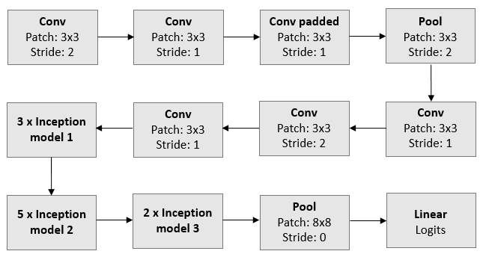
INCEPTION V3
This code implements the InceptionV3 model, which is a deep convolutional neural network architecture for image classification.
The code loads the pre-trained InceptionV3 model from Keras applications, with pre-trained weights on the ImageNet dataset, and excludes the top layer (include_top=False). The input shape is set to (224, 224, 3), which is the expected input size for InceptionV3.
After loading the pre-trained model, a flatten layer is added to convert the output of the model to a 1-dimensional feature vector, followed by a fully connected dense layer with 64 units and a ReLU activation function.
Finally, a dense output layer with 26 units (for 26 possible classes in this case) is added without any activation function, which will output the class probabilities.
The resulting model is a modified version of the pre-trained InceptionV3 model, with a smaller output layer that can be trained on a new classification task.

Slide 27
DENSENET121
The DenseNet121 is a deep convolutional neural network architecture that consists of dense blocks and transition layers. The model is pre-trained on the ImageNet dataset, which makes it capable of identifying a wide range of visual concepts.
The code initializes the DenseNet121 model, loads its pre-trained weights on ImageNet, and sets the input shape to (224, 224, 3). The include_top parameter is set to False, which means that the last fully connected layer (top) of the network is not included in the model. Instead, we add our own fully connected layers.
The next step is to add a flatten layer to convert the output from the convolutional layers to a 1D array. This is done using the Flatten() layer from Keras.
Next, a fully connected layer with 64 neurons and the ReLU activation function is added to the model. This layer is intended to learn higher-level features from the output of the convolutional layers.
Finally, an output layer with 26 neurons is added with a linear activation function. The model is then defined as a Keras model with the input as the input of the pre-trained model and the output as the output of the last fully connected layer.
Overall, this code defines a neural network architecture that fine-tunes the pre-trained DenseNet121 model for the specific task of classifying images into 26 classes

Slide 28
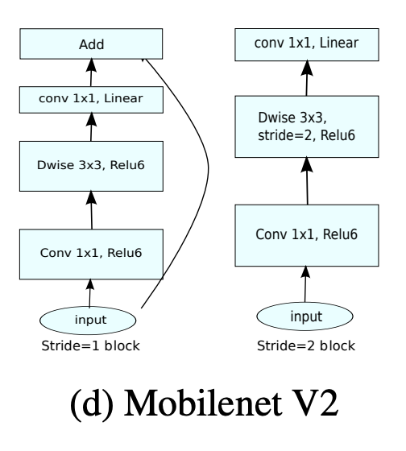
MOBILENETV2
tf.keras.applications.MobileNetV2 - This is the base MobileNetV2 model imported from Keras applications, pre-trained on the ImageNet dataset. It consists of a series of convolutional and depthwise separable convolutional layers, followed by a fully connected layer at the end.
tf.keras.layers.GlobalAveragePooling2D() - This layer takes the output of the MobileNetV2 model and applies global average pooling across the spatial dimensions of the feature map. This reduces the dimensionality of the feature map while retaining important information.
tf.keras.layers.Dense(64, activation='relu') - This is a fully connected layer with 64 units and a ReLU activation function. It takes the output of the global average pooling layer as input and applies a linear transformation to produce a new feature map.
tf.keras.layers.Dense(26) - This is the final fully connected layer with 26 units, which produces the output of the model. It applies another linear transformation to the output of the previous layer to produce the final predictions for the 26 classes.
tf.keras.models.Model(model.input, output) - This line creates a new Keras model that takes the input from the MobileNetV2 model and produces the output from the final dense layer. This new model is then returned as the output of the function.

Slide 29
Training Model

Slide 30
Training Model
The model is trained using the Adam optimizer, which is an algorithm used for stochastic gradient descent optimization. The optimizer is used to minimize the loss function during training by adjusting the weights of the neural network.
During training, the model is first compiled with the chosen optimizer, loss function (in this case, categorical cross-entropy), and evaluation metric (accuracy). Then, the training dataset is passed through the model in batches, and the optimizer updates the weights based on the calculated loss for each batch.
The training process is typically done over several epochs, with each epoch consisting of a full pass through the training dataset. During each epoch, the model is evaluated on the validation dataset to monitor its performance and prevent overfitting. The training is stopped when the validation loss stops improving.
As for the model's training and validation accuracy and loss curves, they would show how the model's performance improved over each epoch of training. Typically, the accuracy should increase and the loss should decrease with each epoch, indicating that the model is learning and improving its predictions. However, it's important to monitor the validation accuracy and loss as well, as they can provide insight into whether the model is overfitting to the training data.

Slide 31
Comparison of Models

Slide 32
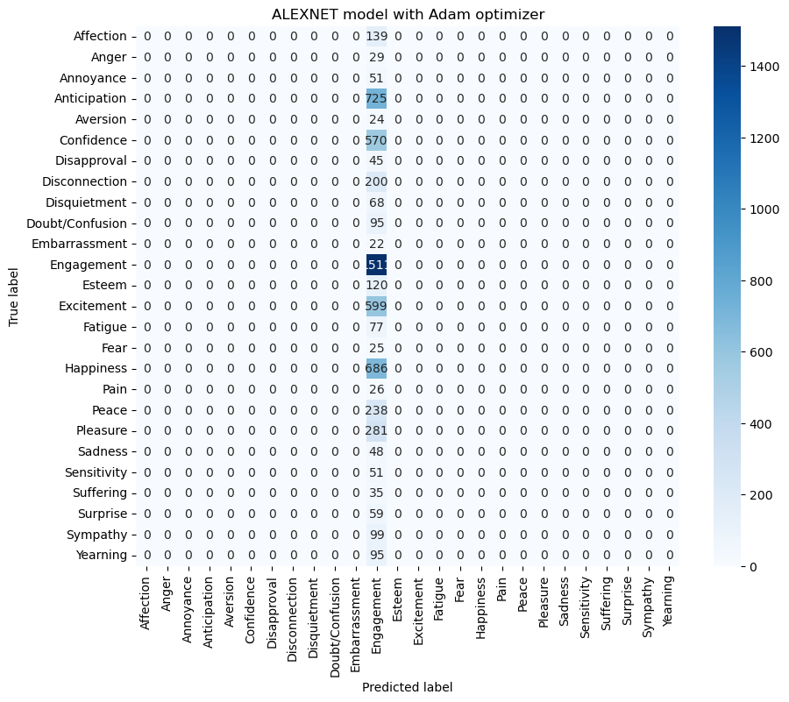
Pre-Trained Model with Adam Optimizer using 10 Epoch
ALEXNET with Adam Optimizer Best Score:
Accuracy: 25.305473804473877 %
Loss: 255.88345527648926 %
Val_Accuracy: 25.53227543830871 %
Val_Loss: 250.99611282348633 %

Slide 33
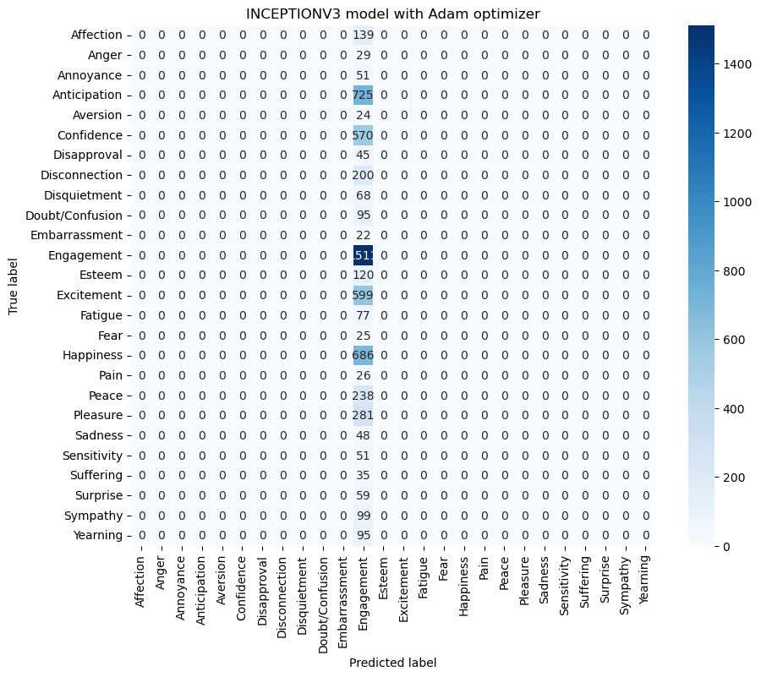
Pre-Trained Model with Adam Optimizer using 10 Epoch
INCEPTIONV3 with Adam Optimizer Best Score:
Accuracy: 25.9345791339874%
Loss: 252.68313884735107%
Val_Accuracy: 25.532275438308716
Val_Loss: 2.52526593208313

Slide 34
Pre-Trained Model with Adam Optimizer using 10 Epoch
ALEXNET with Adam Optimizer Best Score:
Accuracy: 25.305473804473877 %
Loss: 255.88345527648926 %
Val_Accuracy: 25.53227543830871 %
Val_Loss: 250.99611282348633 %

Slide 35
Thank You !!

